Slide 1
System model
1
1. User (Actor):
• The student/user interacts with the platform through the web interface.
• Users can perform actions such as:
• Adding learning items
• Viewing saved items
• Checking reminders
• Managing profile details
2. Frontend Layer (User Interface):
Technologies used: HTML and CSS
This layer provides the visual interface through which users interact with the system.
Current pages developed:
• Add Item Page – Interface to add learning resource links
• My Items Page – Displays saved learning resources
• Reminders Page – Shows reminders for learning items
• Profile Page – Displays user information

Slide 2
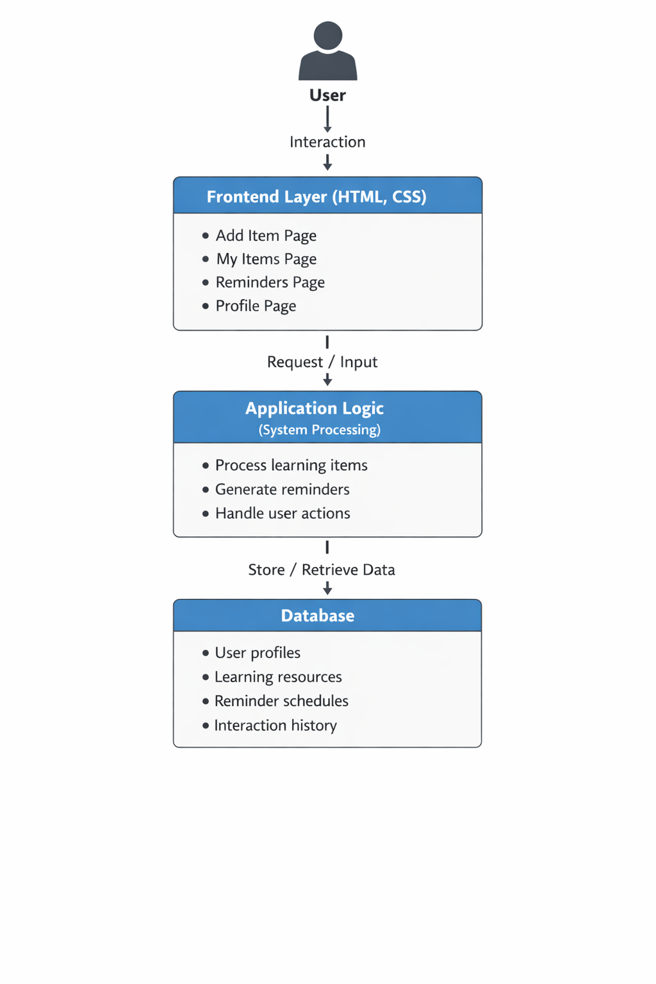
Purpose:
• Collect user input
• Display stored learning items
• Show reminders and notifications
3. Application Layer (System Logic – Future Implementation):
This layer will handle the processing and logic of the system.
Main functions:
• Processing learning item submissions
• Extracting metadata from links
• Tracking user interactions
• Managing reminder scheduling
4. Data Storage Layer (Database – Future)
This layer stores all system data.
Data stored includes:
• User profile information
• Saved learning resources
• Reminder schedules
• Interaction history
Purpose:
• Maintain persistent records of learning items
• Support retrieval and analysis of learning data

Slide 3
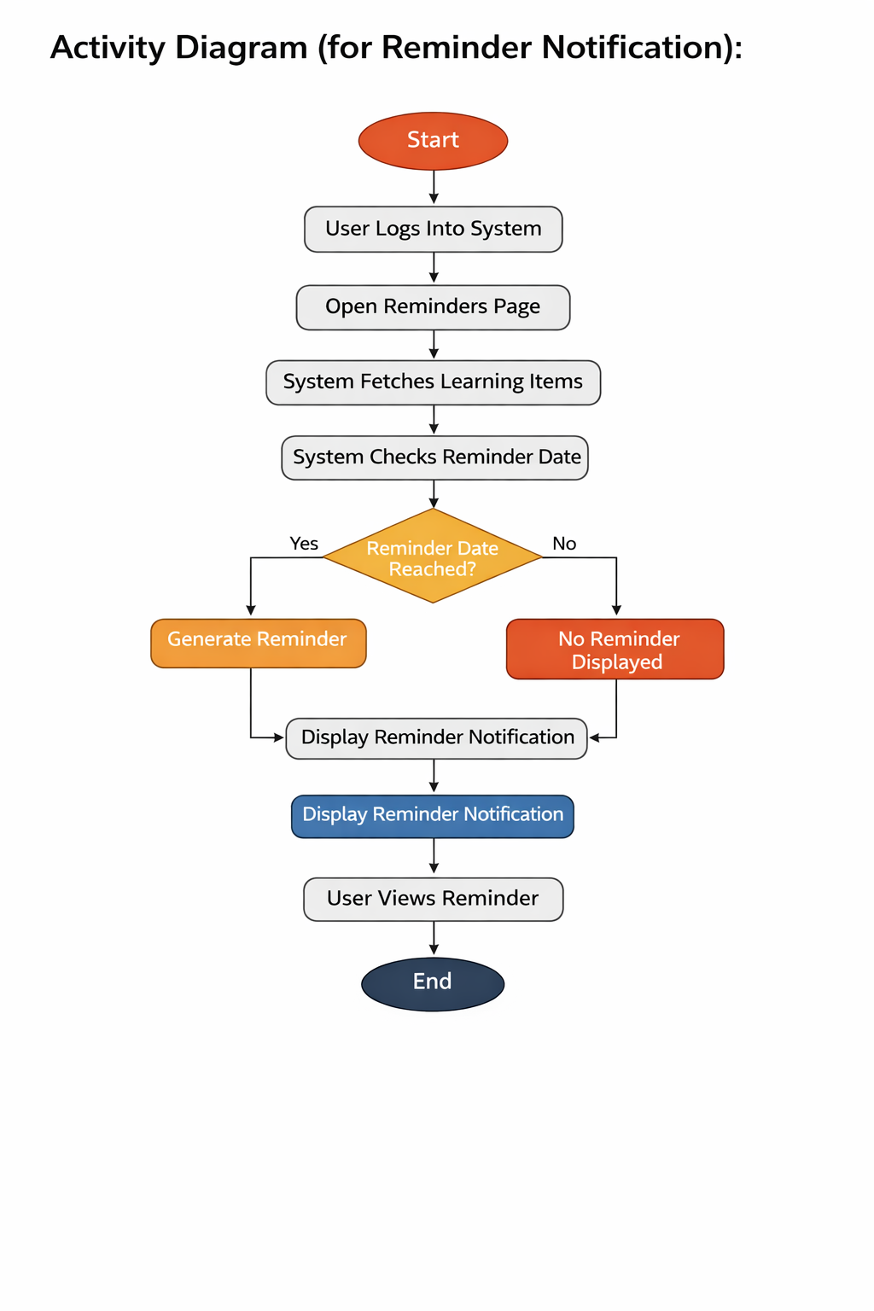
Activity Diagram(for Reminder Notification)

